Slide 1
Introduction to Networks

Slide 2
Table of Contents
What’s a Network?
Local Area Network (LAN)
Common Network Components
Wide Area Network (WAN)

Slide 3
Table of Contents
Network Topology
Physical Network Topologies
Bus Topology
Star Topology
Ring Topology
Mesh Topology
Tree Topology
Hybrid Topology

Slide 4
What’s a Network?
1

Slide 5
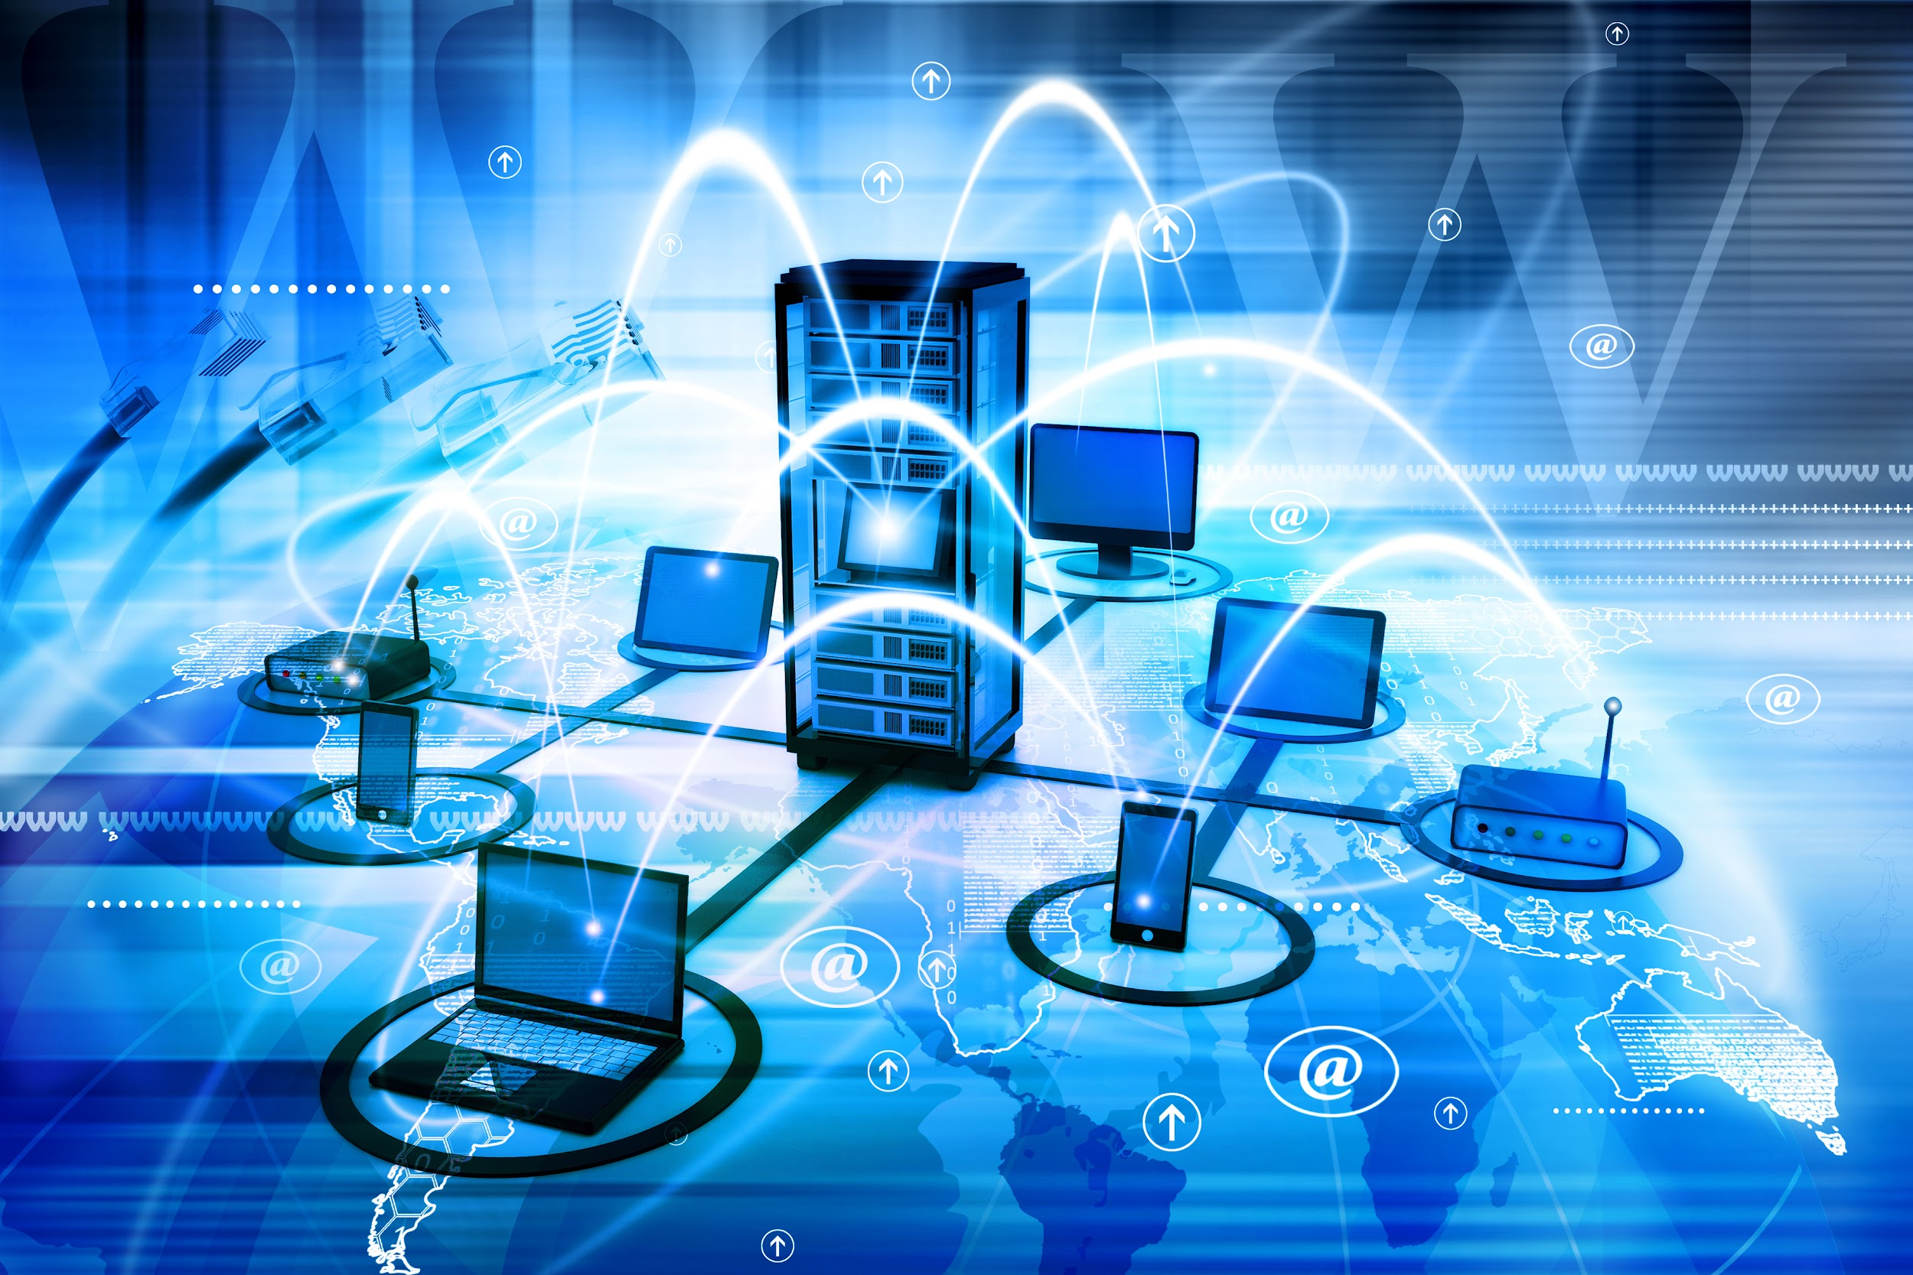
What’s a Network?
A network is two or more computer systems linked together by some form of the transmission medium that enables them to share information
Notes:
A network is two or more computer systems linked together by some form of the transmission medium that enables them to share information. It does not matter whether the network contains two or thousands of machines; the concept is essentially the same.
An excellent example of a network is the Internet, which connects millions of devices all over the world.

Slide 6
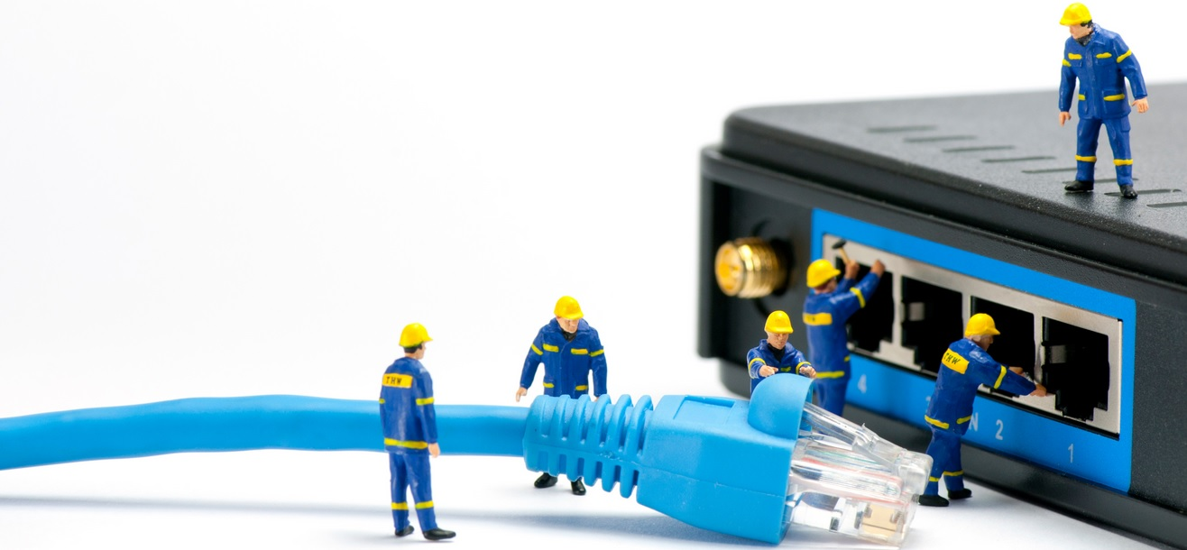
What’s a Network?
Provides services like:
Access to shared files/folders
Access to printers/scanners
Email applications
Database applications
Web applications
Voice over IP (VoIP)
Multimedia conferencing
Notes:
A network will provide services to its users. Historically, these services have included access to shared files, folders, and printers plus email and database applications. Modern networks provide more diverse services, including web applications, Voice over IP, and multimedia conferencing.

Slide 7
What’s a Network?
Performance → Response time
Data Sharing
Features of Computer
Network
Backup
Reliability → No failures!
Security → Keep data safe!
Scalability → New systems can be added
Software and hardware compatibility
Notes:
A computer network has the following features:
Performance: Performance of a computer network is measured in terms of response time. The response time of sending and receiving data from one system.
Data Sharing: One of the reasons why we use a computer network is to share the data between different systems connected with each other through a transmission media.
Backup: A computer network must have a central server that keeps the backup of all the data that is to be shared over a network so that in case of a failure it should be able to recover the data faster.
Reliability: There should not be any failure in the network or if it occurs the recovery from failure should be fast.
Security: A computer network should be secure so that the data transmitting over a network should be safe from unauthorized access. Also, the sent data should be received as it is at the receiving node, which means there should not be any loss of data during transmission.
Scalability: A computer network should be scalable which means it should always allow adding new computers (or nodes) to the already existing computer network. For example, a company runs 100 computers over a computer network for their 100 employees, let's say they hire another 100 employees and want to add new 100 computers to the already existing LAN then, in that case, the local area computer network should allow this.
Software and hardware compatibility: A computer network must not limit all the computers in a computer network to use the same software and hardware, instead, it should allow the better compatibility between the different software and hardware configuration.

Slide 8
Local Area Network (LAN)
2

Slide 9
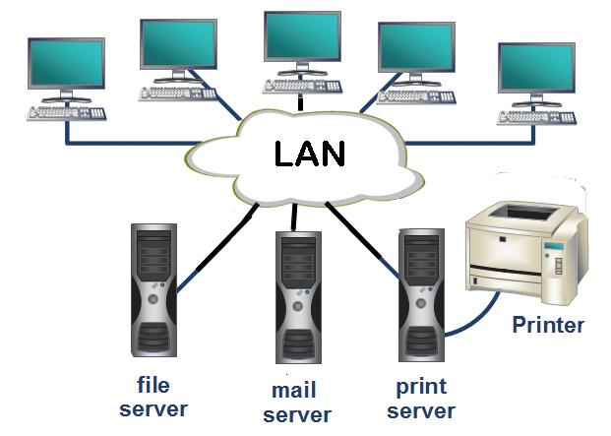
Local Area Network (LAN)
A LAN is a local network
Could be as small as two computers or large, with thousands of devices connected
Usually restricted to spanning a particular geographic location
Notes:
A LAN is, as the name implies, a local network. This network could be as small as two computers that are connected to each other or large, with thousands of devices connected. The keyword here is “local”.
A LAN is usually restricted to spanning a particular geographic location such as an office building, a single department within a corporate office, or even a home office.

Slide 10



A company in a single building is considered as LAN
True
False
Notes:
🍐 This is a Pear Deck Multiple Choice Slide. Your current options are: A: True, B: False,
🍐 To edit the type of question or choices, go back to the "Ask Students a Question" in the Pear Deck sidebar.
True or False
Use this template to do a quick check of students’ perceptions during your lesson.

Slide 11
A company consisting of multiple buildings in the same area is considered as LAN
True
False
Notes:
🍐 This is a Pear Deck Multiple Choice Slide. Your current options are: A: True, B: False,
🍐 To edit the type of question or choices, go back to the "Ask Students a Question" in the Pear Deck sidebar.
True or False
Use this template to do a quick check of students’ perceptions during your lesson.

Slide 12
Local Area Network (LAN)
LAN’s size and the distance a LAN can span is not restricted
But it’s best to split a big LAN into smaller logical zones known as workgroups to make administration easier
Notes:
Because of technological advances, we’re not nearly as restricted in regard to both a LAN’s size and the distance a LAN can span. Even so, it’s still best to split a big LAN into smaller logical zones known as workgroups to make administration easier.
A workgroup is a peer-to-peer network setup using the Microsoft Windows operating system. It’s a group of computers on a local area network that share common resources and responsibilities.
Throughout this lesson, we use the term workgroup slightly differently than the name suggests. We will simply use workgroup to refer to the computers (or any other devices that connect to the network) that are physically are in the same network segment.

Slide 13
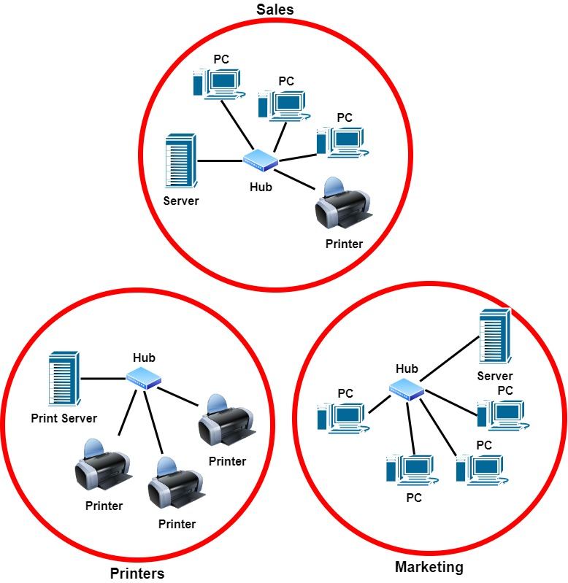
Local Area Network (LAN)
3 LANs, each has its own workgroup
Notes:
In a typical business environment, it’s a good idea to arrange your LAN’s workgroups along with department divisions; for instance, you would create a workgroup for Accounting, another one for Sales, and maybe another for Marketing or printing jobs.
The figure shows 3 separate LANs, each as its own workgroup.
There are 3 LANs in the picture because none of the workgroups is connected to each other. To overcome this problem we can simply use a router to connect 3 LANs into one LAN with 3 workgroups.

Slide 14
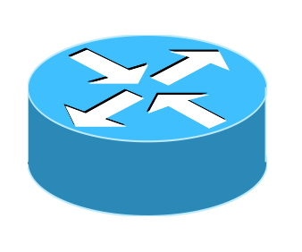
Local Area Network (LAN)
A LAN with 3 workgroups
Notes:
In a typical business environment, it’s a good idea to arrange your LAN’s workgroups along with department divisions; for instance, you would create a workgroup for Accounting, another one for Sales, and maybe another for Marketing or printing jobs.
The figure shows 3 separate LANs, each as its own workgroup.
There are 3 LANs in the picture because none of the workgroups is connected to each other. To overcome this problem we can simply use a router to connect 3 LANs into one LAN with 3 workgroups.

Slide 15
Common Network Components
3

Slide 16
Common Network Components
Node
Station
A point or joint where a connection takes place
Can be a computer or device
A node on a wireless network
PC - Printer
Laptop - Router
Server - Switch Smartphone - etc.
Some examples of Node
Notes:
A node is any device that can communicate on the network via one or more network interfaces. The term node can be used to describe endpoint devices, such as computers, laptops, servers, IP phones, smartphones, or printers, and connecting or forwarding devices, such as switches and routers.
A node on a wireless network is often called a station.

Slide 17
Common Network Components
Host
Workstation
Requires IP Address
Can be a client or server
- Powerful computer designed for technical or scientific applications
- Used by one person at a time
Notes:
A host (also known as "network host") is a computer or other device that communicates with other hosts on a network. Hosts typically do not include intermediary network devices like switches and routers, which are instead often categorized as nodes. Hosts require unique IP addresses.
A workstation refers to an individual computer, or group of computers, used by a single user to run technical or scientific applications.

Slide 18
Common Network Components
Server
Client
A powerful computer used to store files and run programs centrally
A device that makes request from a server
Web Server - Application Server
Proxy Server - DNS Server
Mail Server - File Server
Print Server - Telephony Server
Common types of servers
Notes:
A network server is a powerful computer used to store files and run programs centrally. A server can improve file management and security and make it easier for employees to collaborate.
The device that makes the request, and receives a response from the server, is called a client.

Slide 19
Common Network Components
Segment
Backbone
Refers to a specific physical region of a network
Typical usage is to describe the link between a computer and a switch
Another usage is to refer to a region of the network where all the nodes use the same type of transmission media
A fast link between other segments of
a network
Notes:
The term segment can be used to refer to a specific physical region of a network, though the scope of a segment depends on the exact technology in use. One typical usage now is to describe the link between a computer and a switch. Another usage is to refer to a region of the network where all the nodes use the same type of transmission media and have the same bandwidth.
A network is typically divided into segments either to cope with the physical restrictions of the network media used or to improve performance or to improve security (or all three).
A backbone describes a fast link between other segments of a network. The backbone carries all the communications occurring between nodes in separate segments.

Slide 20
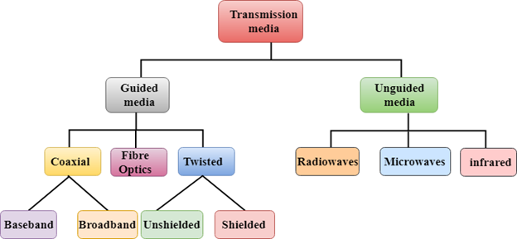
Common Network Components
Transmission Media
A communication channel between nodes that carries the information from the sender to the receiver
Data is transmitted through the electromagnetic signals
Notes:
Transmission media is a communication channel between nodes that carries the information from the sender to the receiver. Data is transmitted through the electromagnetic signals.
The main functionality of the transmission media is to carry the information in the form of bits through LAN.
In a copper-based network, the bits are sent in the form of electrical signals.
In a fiber based network, the bits are sent in the form of light pulses.
In wireless network, the bits are sent in the form of radio waves.

Slide 21
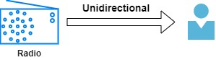
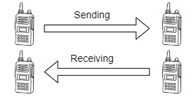
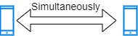
Cable Properties
Simplex
Half-duplex
Full-duplex
Notes:
Simplex mode:
In simplex mode, Sender can send the data but can’t receive any data. It is a unidirectional communication.
Half-duplex mode:
In half duplex mode, Sender can send the data and also can receive the data but one at a time. It is two-way directional communication but one at a time.
Full duplex mode:
In full duplex mode, Sender can send the data and also can receive the data simultaneously. It is two-way directional communication simultaneously.

Slide 22
Wide Area Network (WAN)
4

Slide 23
Wide Area Network (WAN)
A WAN is a collection of computers and devices connected by a communications network over a wide geographic area
WANs are commonly connected either through the Internet or special arrangements made with phone companies or other service providers
The Internet is considered the largest WAN in the world
Notes:
Short for wide area network, a WAN is a collection of computers and devices connected by a communications network over a wide geographic area. Wide area networks are commonly connected either through the Internet or special arrangements made with phone companies or other service providers.
The Internet is a collection of networks and is considered the largest WAN in the world.

Slide 24
Network Topology
5

Slide 25
Network Topology
Network topology is the description of the arrangement of nodes and connections in a network
Network Topology
Physical Topology
Logical Topology
Notes:
Network topology is the description of the arrangement of nodes (e.g. switches and routers) and connections in a network, often represented as a graph.
No matter how identical two organizations are, no two networks are exactly alike. However, many organizations are relying on well-established network topology models. Network topologies outline how devices are connected together and how data is transmitted from one node to another.
Physical and logical topologies are two basic categories of network topologies.

Slide 26
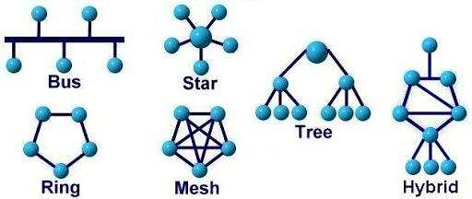
Network Topology
A physical topology details how devices are physically connected
Depends on:
- Office layout
- Troubleshooting techniques
- Cost of installation
- Type of cable used
Notes:
The shape of the cabling layout used to link devices is called the physical topology of the network. This refers to the layout of cabling, the locations of nodes, and the interconnections between the nodes and the cabling. The physical topology of a network is determined by the capabilities of the network access devices and media, the level of control or fault tolerance desired, and the cost associated with cabling or telecommunications circuits.
The physical topology you choose for your network depends on:
Office Layout
Troubleshooting Techniques
Cost of Installation
Type of cable used

Slide 27
Network Topology
Logical topology describes the way in which a network transmits information from network/computer to another
It’s not the way the network looks or how it is laid out
Notes:
Logical topology describes the way in which a network transmits information from network/computer to another and not the way the network looks or how it is laid out. The logical layout also describes the different speeds of the cables being used from one network to another.
The logical topology, in contrast to the "physical", is the signals act on the network media, or the way that the data passes through the network from one device to the next without regard to the physical interconnection of the devices. A network's logical topology is not necessarily the same as its physical topology. For example, twisted pair Ethernet is a logical bus topology in a physical star topology layout. While IBM's Token Ring is a logical ring topology, it is physically set up in a star topology.
The logical classification of network topologies generally follows the same classifications as those in the physical classifications of network topologies but describes the path that the data takes between nodes being used as opposed to the actual physical connections between nodes.

Slide 28
Physical Network Topologies
6
Bus Topology Star Topology
Ring Topology Mesh Topology
Tree Topology Hybrid Topology

Slide 29
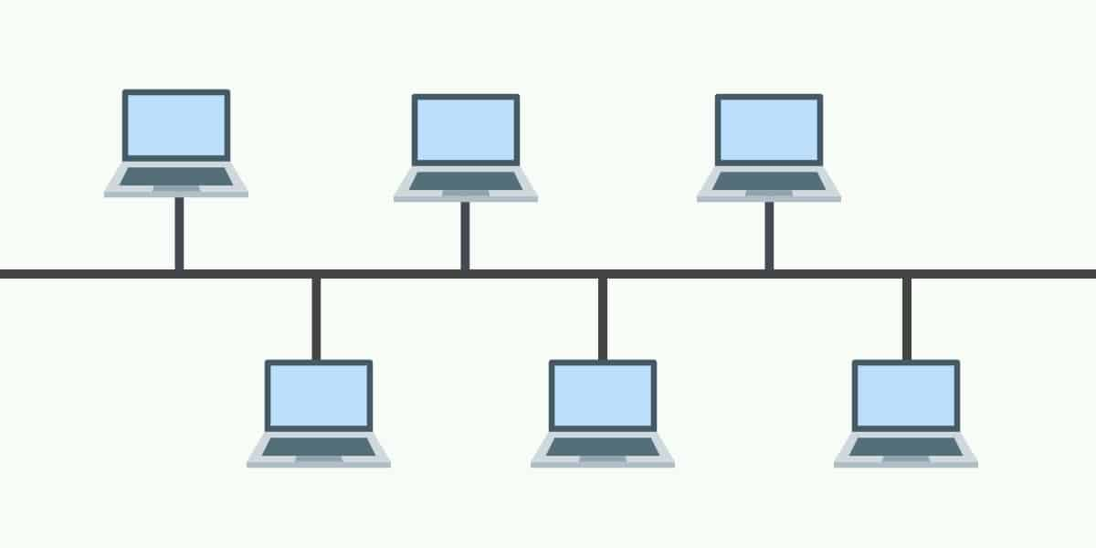


Physical Network Topologies
Bus Topology:
Every node is connected in series along a linear path
backbone
If backbone fails entire network goes down
Keeps the layout simple
Decreased network performance
Cost effective
Not scalable
Notes:
In the bus network topology, every node is connected in series along a linear path. This arrangement is found today primarily in cable broadband distribution networks.
Advantages
Bus topologies were often used in smaller networks. One of the main reasons is that they keep the layout simple. All devices are connected to a single cable so you don’t need to manage a complex topological setup.
The layout also helped make bus topologies cost effective because they can be run with a single cable. In the event that more devices need to be added then you could simply join your cable to another cable.
Disadvantages
However, relying on one cable does mean that bus topologies have a single point of failure. If the cable fails then the entire network will go down. A cable failure would cost organizations a lot of time while they attempt to resume service. Further to this, high network traffic would decrease network performance because all the data travels through one cable.
Not scalable as there is a limit of how many nodes you can connect with backbone cable.

Slide 30
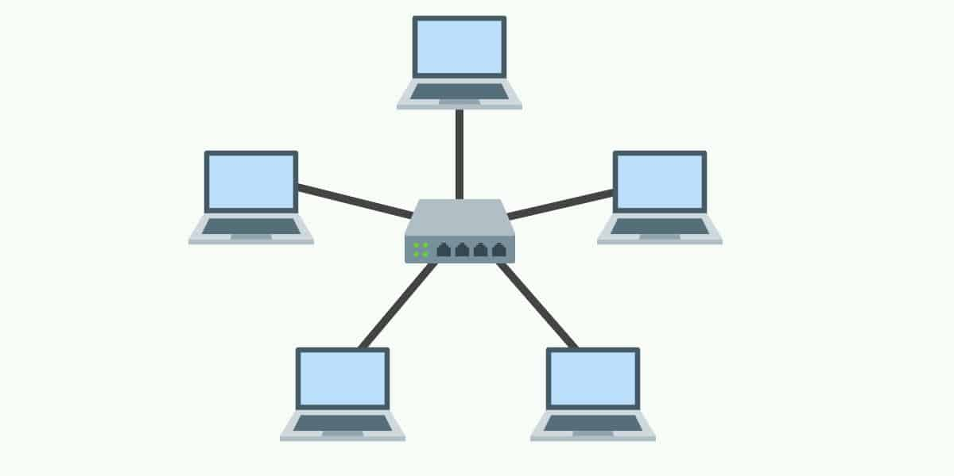
Physical Network Topologies
Star Topology:
Every node in the network is connected to one central switch
Easy to manage
If central switch fails entire network goes down
Requires fewer cables
Performance is up to central switch
Notes:
A star topology is a topology where every node in the network is connected to one central switch. Every device in the network is directly connected to the switch and indirectly connected to every other node. The relationship between these elements is that the central network device is a server and other devices are treated as clients. The central node has the responsibility of managing data transmissions across the network and acts as a repeater.
Advantages
Star topologies are most commonly-used because you can manage the entire network from one location: the central switch. As a consequence, if a node that isn’t the central node goes down then the network will remain up. This gives star topologies a layer of protection against failures that aren’t always present with other topology setups. Likewise, you can add new computers without having to take the network offline like you would have to do with a ring topology.
In terms of physical structure, star topologies require fewer cables than other topology types. This makes them simple to set up and manage over the long-term. The simplicity of the overall design makes it much easier for administrators to run troubleshooting when dealing with performance faults.
Disadvantages
Though star topologies may be relatively safe from failure, if the central switch goes down then the entire network will go down. As such, the administrator needs to manage the health of the central node closely to make sure that it doesn’t go down. The performance of the network is also tied to the central node’s configurations and performance. Star topologies are easy to manage in most ways but they are far from cheap to set up and use.

Slide 31
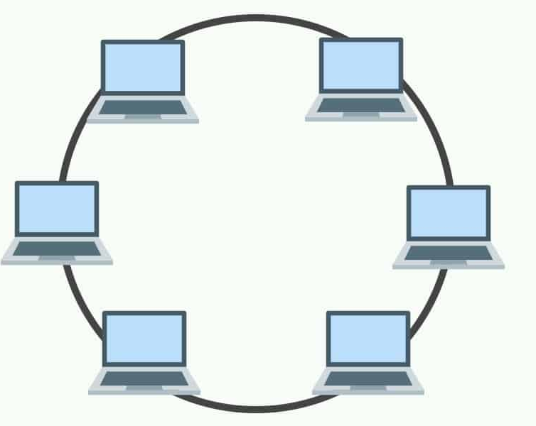
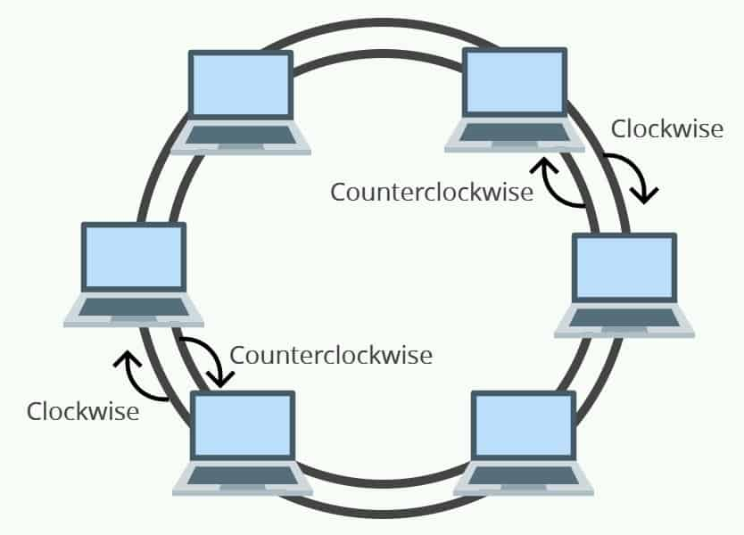
Physical Network Topologies
Ring Topology:
Every node is connected to each other in a circular format.
Low risk of packet collision
Vulnerable to failure
The more devices added the more communication delay
Easy to install
To make changes the network should be shut down
Notes:
In networks with a ring topology, computers are connected to each other in a circular format. Every device in the network will have two neighbors and no more or no less. Ring topologies were commonly used in the past but you would be hard pressed to find an enterprise still using them today.
The first node is connected to the last node to link the loop together. As a consequence of being laid out in this format packets need to travel through all nodes on the way to their destination.
Within this topology, one node is chosen to configure the network and monitor other devices. Ring topologies are half-duplex but can also be made full-duplex. To make ring topologies full-duplex you would need to have two connections between network nodes to form a Dual Ring Topology.
Advantages
In ring topologies the risk of packet collisions is very low due to the use of token-based protocols, which only allow one station to transmit data at a given time. This is compounded by the fact that data can move through nodes at high speeds which can be expanded on when more nodes are added.
Dual ring topologies provided an extra layer of protection because they were more resistant to failures. For instance, if a ring goes down within a node then the other ring can step up and back it up. Ring topologies were also low cost to install.
Disadvantages
One of the reasons why ring topologies were replaced is because they are very vulnerable to failure. The failure of one node can take the entire network out of operation. This means that ring topology networks needed to be constantly managed to ensure that all nodes are in good health. However, even if the nodes were in good health your network could still be knocked offline by a transmission line failure!
Ring topologies also raised scalability concerns. For instance, bandwidth is shared by all devices within the network. In addition, the more devices that are added to a network the more communication delay the network experiences. This means that the number of devices added to a network topology needed to be monitored carefully to make sure that the network resources weren’t stretched beyond their limit.
Making changes to a ring topology was also complicated because you need to shut down the network to make changes to existing nodes or add new nodes. This is far from ideal as you’ll need to factor in downtime every time you want to make a change to the topological structure!

Slide 32
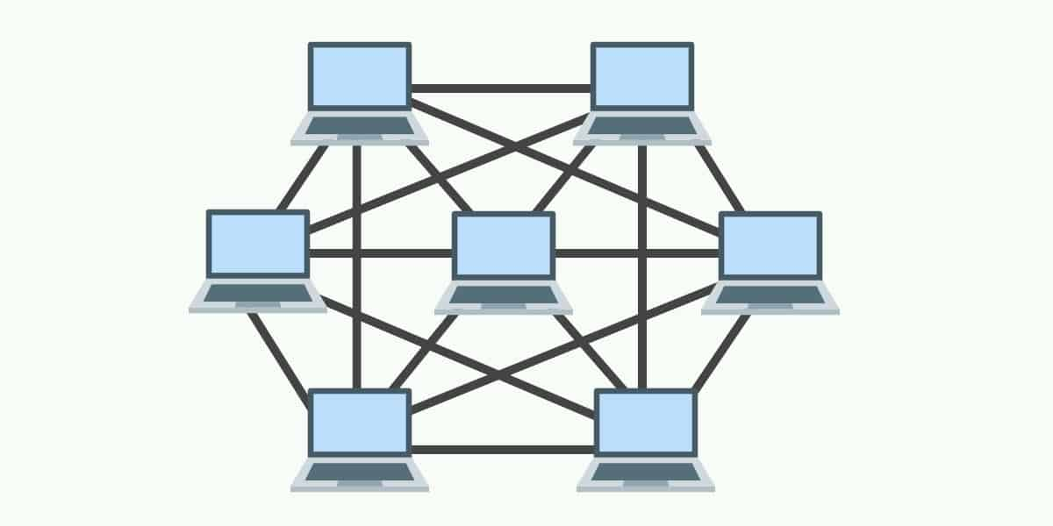
Physical Network Topologies
Mesh Topology:
A point-to-point connection where nodes are interconnected
Reliable
Configuration is complex
Expensive
Notes:
A mesh topology is a point-to-point connection where nodes are interconnected. In this form of topology, data is transmitted via two methods: routing and flooding. Routing is where nodes use routing logic to work out the shortest distance to the packet’s destination. In contrast, flooding is where data is sent to all nodes within the network. Flooding doesn’t require any form of routing logic to work.
Advantages
Mesh topologies are used first and foremost because they are reliable. The interconnectivity of nodes makes them extremely resistant to failures. There is no single machine failure that could bring down the entire network. The absence of a single point of failure is one of the reasons why this is a popular topology choice. This setup is also secure from being compromised.
Disadvantages
However, mesh topologies are far from perfect. They require an immense amount of configuration once they are deployed. The topological layout is more complex than many other topologies and this is reflected by how long it takes to set up. You’ll need to accommodate a whole host of new wiring which can add up to be quite expensive.

Slide 33
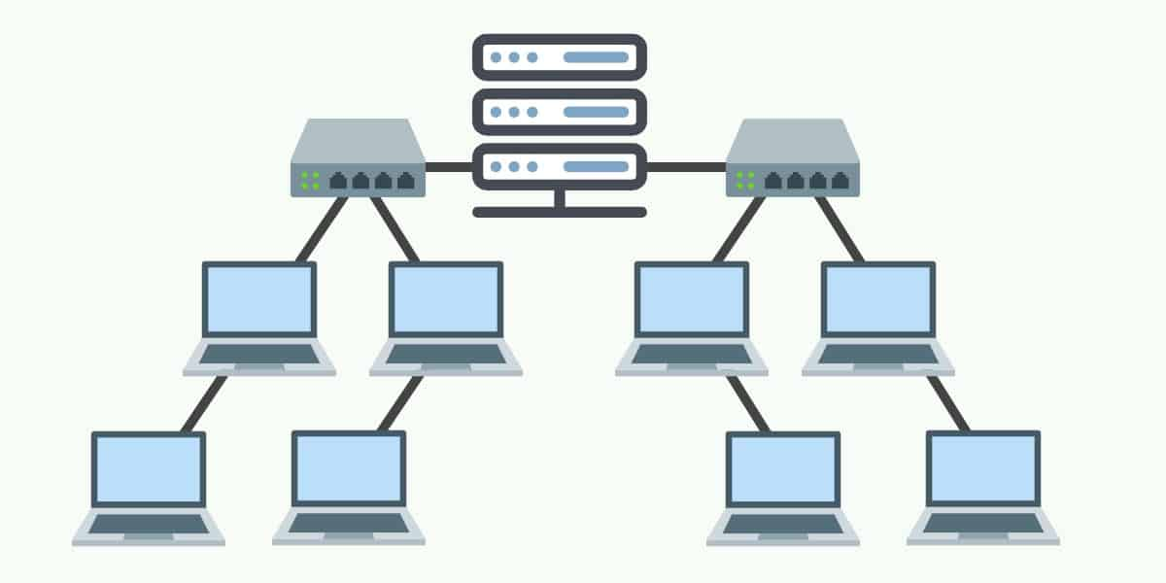
Physical Network Topologies
Tree (Hierarchy) Topology:
A network structure that is shaped like a tree with its many branches
Root
Scalable
Hard to maintain
Manageable
If root fails entire network goes down
Notes:
As the name suggests, a tree topology is a network structure that is shaped like a tree with its many branches. Tree topologies have a root node which is connected to other node hierarchy. The hierarchy is parent-child where there is only one mutual connection between two connected nodes. As a general rule, a tree topology needs to have three levels to the hierarchy in order to be classified this way. This form of topology is used within Wide Area Networks to sustain lots of spread-out devices.
Advantages
The main reason why tree topologies are used is to extend bus and star topologies. Under this hierarchical format, it is easy to add more nodes to the network when your organization grows in size. This format also lends itself well to finding errors and troubleshooting because you can check for performance issues systematically throughout the tree.
Disadvantages
The most significant weakness of tree topology is the root node. If the root node fails then all of its subtrees become partitioned. There will still be partial connectivity within the network amongst other devices such as the failed node’s parent.
Maintaining the network is not simple either because the more nodes you add, the more difficult it becomes to manage the network. Another disadvantage of a tree topology is the number of cables you need. Cables are required to connect every device throughout the hierarchy which makes the layout more complex when compared to a simpler topology.

Slide 34
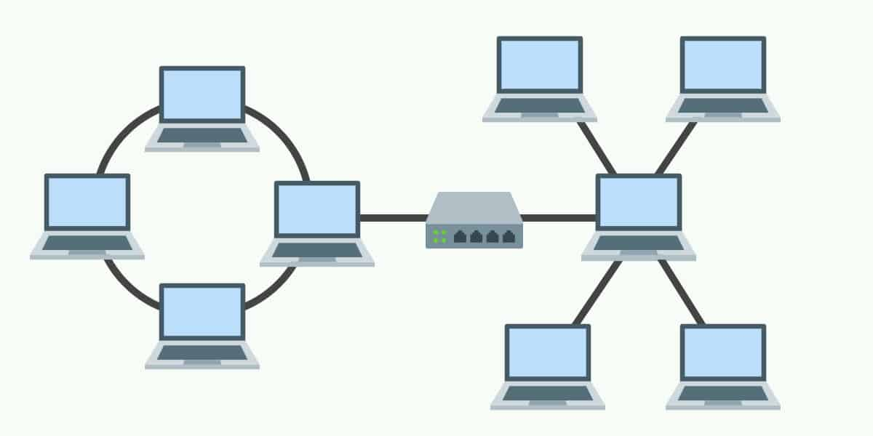
Physical Network Topologies
Hybrid Topology:
A combination of two or more types of physical or logical network topologies working together within the same network
Flexibility
Quite complex
Can be quite costly
Notes:
When a topology is comprised of two or more different topologies it is referred to as a hybrid topology. Hybrid topologies are most-commonly encountered in larger enterprises where individual departments have network topologies that different from another topology in the organization. Connecting these topologies together will result in a hybrid topology. As a consequence, the capabilities and vulnerabilities depend on the types of topology that are tied together.
Advantages
There are many reasons why hybrid topologies are used but they all have one thing in common: flexibility. There are few constraints on the structure that a hybrid topology cannot accommodate, and you can incorporate multiple topologies into one hybrid setup. As a consequence, hybrid topologies are very scalable. The scalability of hybrid setups makes them well-suited to larger networks.
Disadvantages
Unfortunately, hybrid topologies can be quite complex, depending on the topologies that you decide to use. Each topology that is part of your hybrid topology will have to be managed according to its unique requirements. This makes administrators’ jobs more difficult because they are going to have to attempt to manage multiple topologies rather than a single one. In addition, setting up a hybrid topology can end up being quite costly.

Slide 35
THANKS!
Any questions?
You can find me at:
@David - Instructor
david@clarusway.com

Slide 36
Open System Interconnection (OSI) Specifications

Slide 37
Table of Contents
What is OSI Reference Model?
Layers of OSI Model
Data Encapsulation

Slide 38
What is OSI Reference Model?
1
Notes:
Kablolu ve kablosuz ağlar için IEEE
80 yılınınn şubat ayında çıkmış

Slide 39
What is OSI Reference Model?
The OSI provides a standard for different computer systems to be able to communicate with each other
Developed by ISO in 1984
Notes:
Open System Interconnection (OSI)
Başlangıçta, ağların gelişimi kaotikti. Her satıcının kendi tescilli çözümü vardı. İşin kötü yanı, bir satıcının çözümünün başka bir satıcının çözümüyle uyumlu olmamasıydı. OSI modeli fikri burada doğdu,
ağlara katmanlı bir yaklaşımla,
donanım satıcılarımız ağ için donanım tasarlayacak ve diğerleri uygulama katmanı için yazılım geliştirebilecekti.
Herkesin üzerinde mutabık kaldığı açık bir model kullanmak, birbiriyle uyumlu ağlar kurabileceğimiz anlamına gelir.
Uluslararası Standardizasyon Örgütü (ISO) bu sorunu çözmek için farklı ağ modellerini araştırdı ve sonuç, 1984'te piyasaya sürülen OSI modeli oldu.
Günümüzde çoğu satıcı, OSI modeline dayalı ağlar oluşturuyor ve farklı satıcıların donanımları uyumlu
In the beginning, the development of networks was chaotic. Each vendor had its own proprietary solution. The bad part was that one vendor’s solution was not compatible with another vendor’s solution. This is where the idea for the OSI model was born, having a layered approach to networks our hardware vendors would design hardware for the network, and others could develop software for the application layer. Using an open model which everyone agrees on means we can build networks that are compatible with each other.
To fix this problem the International Organization for Standardization (ISO) researched different network models and the result is the OSI-model which was released in 1984. Nowadays most vendors build networks based on the OSI model and hardware from different vendors is compatible

Slide 40
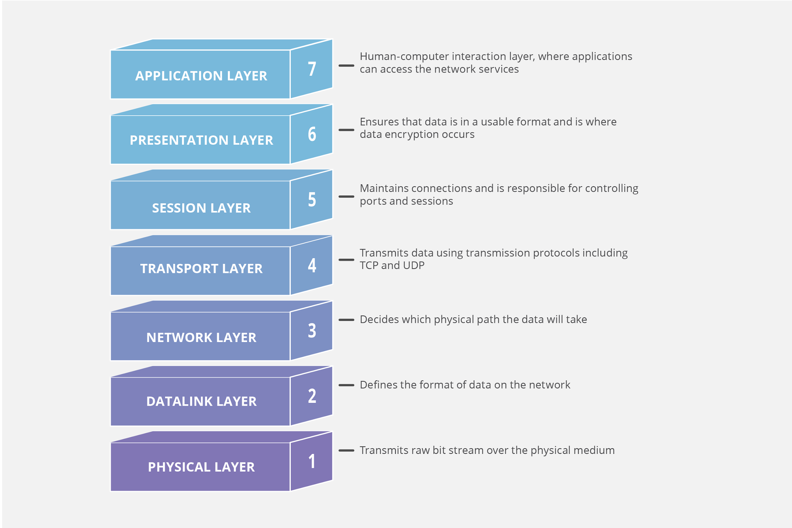
What is OSI Reference Model?
- Human-computer interaction layer, where applications can access the network services
Upper Layers
(OS)
- Ensures that data is in a usable format and is where data encryption occurs
- Maintains connections and is responsible for controlling ports and sessions
- Transmits data using transmission protocols including TCP and UDP
- Decides which physical path the data will take
Lower Layers
(Network)
- Defines the format of the data on the network
- Transmits raw bit stream over the physical medium
Notes:
Switch en alt 2 katman
Rooter 4 katman
Her internet yazılımı 7 de
4 de tcp ve udp denseçilene göre ek bilgiler geliyor
Paketlere ayrılıyor numaralandırıyor
3 de hedef IP kaynak Ip
2 mac adresleri ekleniyor
1 bit seviyesinde iletim
üst katmanlar - İşletim sistemi ve uygulamalar/yazılım
alt katmanlar - Ağ ve fiziksel ortam
7-Uygulamaların ağ hizmetlerine erişebildiği insan-bilgisayar etkileşim katmanı
6-Verilerin kullanılabilir bir biçimde olmasını ve veri şifrelemenin gerçekleştiği yerde olmasını sağlar
5-Bağlantıları sürdürür ve bağlantı noktalarını ve oturumları kontrol etmekten sorumludur
4-TCP ve UDP (User Datagram Protocol) dahil olmak üzere iletim protokollerini kullanarak veri iletir
3-Verilerin hangi fiziksel yolu izleyeceğine karar verir
2-Ağdaki verilerin biçimini tanımlar
1-Ham bit akışını fiziksel ortam üzerinden iletir
OSI modeli, bilgisayar ağları için evrensel bir dil olarak görülebilir.
Bir iletişim sistemini, her biri bir sonrakinin üzerine yığılmış yedi soyut katmana bölme konseptine dayanır.
Bilgisayar donanımı ve yazılımının karmaşıklığı arttıkça, bu sistemler arasında başarılı bir şekilde iletişim kurma sorunu daha da zorlaşmaktadır.
Bu zor problemlerin "alt görevlere" bölünmesi, bunların kolayca anlaşılmasını ve daha kolay çözülmesini sağlar.
Bu katmanlı yaklaşımın kullanılması, bir satıcının diğerlerini etkilemeden belirli bir katman için tasarım ve hata ayıklama üzerinde çalışabileceği anlamına gelir.
-Human-computer interaction layer, where applications can access the network services
-Ensures that data is in a usable format and is where data encryption occurs
-Maintains connections and is responsible for controlling ports and sessions
-Transmits data using transmission protocols including TCP and UDP
- Decides which physical path the data will take
- Defines the format of the data on the network
- Transmits raw bit stream over the physical medium
The OSI model can be seen as a universal language for computer networking. It’s based on the concept of splitting up a communication system into seven abstract layers, each one stacked upon the last.
As the complexity of computer hardware and software increases, the problem of successfully communicating between these systems becomes more difficult. Dividing these difficult problems into "sub-tasks" allows them to be readily understood and solved more easily. Using this layered approach means that a vendor can work on the design and debugging for a particular layer without affecting any of the others.
upper layers - Operating system and applications/software
lower layers - Network and physical media

Slide 41
Layers of the OSI Model
Physical Layer
Data Link Layer
Network Layer
Transport Layer
Session Layer
Presentation Layer
Application Layer
2

Slide 42
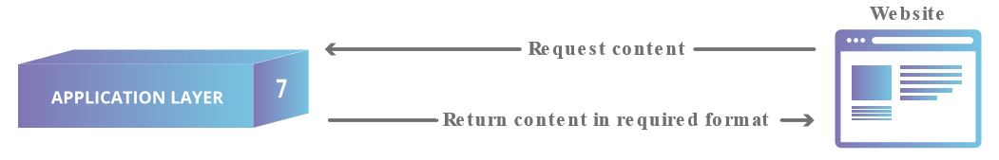
Application Layer (Layer 7)
Directly interacts with data from the user
Software applications (web browsers, email clients, etc.) rely on the application layer to initiate communications
Notes:
Her uygulama 7. katmanda
İstek paketi oluştur
Kullanıcıdan gelen verilerle doğrudan etkileşime girer
Yazılım uygulamaları (web tarayıcıları, e-posta istemcileri, vb.) iletişimi başlatmak için uygulama katmanına güvenir.
Bu, kullanıcıdan gelen verilerle doğrudan etkileşime giren tek katmandır.
Web tarayıcıları ve e-posta istemcileri gibi yazılım uygulamaları, iletişimi başlatmak için uygulama katmanına güvenir.
Ancak, istemci yazılım uygulamalarının uygulama katmanının bir parçası olmadığı açıkça belirtilmelidir; bunun yerine uygulama katmanı, yazılımın kullanıcıya anlamlı veriler sunmak için kullandığı protokollerden ve veri işlemeden sorumludur.
Uygulama katmanı protokolleri, HTTP'nin yanı sıra SMTP'yi de içerir (Basit Posta Aktarım Protokolü, e-posta iletişimini sağlayan protokollerden biridir).
Directly interacts with data from the user
Software applications (web browsers, email clients, etc.) rely on the application layer to initiate communications
This is the only layer that directly interacts with data from the user. Software applications like web browsers and email clients rely on the application layer to initiate communications. But it should be made clear that client software applications are not part of the application layer; rather the application layer is responsible for the protocols and data manipulation that the software relies on to present meaningful data to the user. Application layer protocols include HTTP as well as SMTP (Simple Mail Transfer Protocol is one of the protocols that enables email communications).

Slide 43
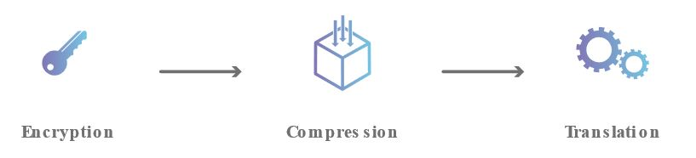
Presentation Layer (Layer 6)
Primarily responsible for preparing data
Translates, encrypts, and compresses data
Notes:
Verilerin hazırlanmasından birincil derecede sorumlu
Verileri çevirir, şifreler ve sıkıştırır
Bu katman, öncelikle verilerin uygulama katmanı tarafından kullanılabilmesi için hazırlanmasından sorumludur; başka bir deyişle, katman 6, verileri uygulamaların tüketmesi için sunulabilir hale getirir.
Sunum katmanı, verilerin çevrilmesinden, şifrelenmesinden ve sıkıştırılmasından sorumludur.
İki cihaz farklı kodlama yöntemleri kullanarak iletişim kurar, bu nedenle katman 6, gelen verileri alıcı cihazın uygulama katmanının anlayabileceği bir sözdizimine çevirmekten sorumludur.
Cihazlar şifreli bir bağlantı üzerinden iletişim kuruyorsa, katman 6, uygulama katmanına şifrelenmemiş, okunabilir veriler sunabilmesi için gönderici tarafındaki şifrelemeyi eklemek ve alıcı tarafındaki şifrelemenin kodunu çözmekten sorumludur.
Son olarak sunum katmanı, uygulama katmanından aldığı verileri 5. katmana iletmeden önce sıkıştırmaktan da sorumludur.
Bu, aktarılacak veri miktarını en aza indirerek iletişimin hızını ve verimliliğini artırmaya yardımcı olur.
Primarily responsible for preparing data
Translates, encrypts, and compresses data
This layer is primarily responsible for preparing data so that it can be used by the application layer; in other words, layer 6 makes the data presentable for applications to consume. The presentation layer is responsible for translation, encryption, and compression of data.
Two devices communicate using may be different encoding methods, so layer 6 is responsible for translating incoming data into a syntax that the application layer of the receiving device can understand.
If the devices are communicating over an encrypted connection, layer 6 is responsible for adding the encryption on the sender’s end as well as decoding the encryption on the receiver's end so that it can present the application layer with unencrypted, readable data.
Finally the presentation layer is also responsible for compressing data it receives from the application layer before delivering it to layer 5. This helps improve the speed and efficiency of communication by minimizing the amount of data that will be transferred.

Slide 44
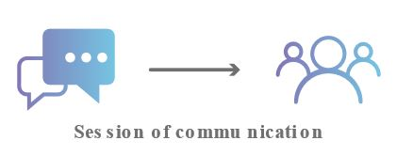
Session Layer (Layer 5)
Responsible for opening and closing communication between the two devices
The time between when the communication is opened and closed is known as the session
Synchronizes data transfer
Notes:
İki cihaz arasındaki iletişimin açılması ve kapatılmasından sorumlu
İletişimin açılıp kapanması arasındaki süreye oturum denir.
Veri aktarımını senkronize eder
Bu, iki cihaz arasındaki iletişimi açıp kapatmaktan sorumlu olan katmandır.
İletişimin açılıp kapanması arasındaki süreye oturum denir.
Oturum katmanı, değiş tokuş edilen tüm verileri aktarmak için oturumun yeterince uzun süre açık kalmasını sağlar ve ardından
kaynakların boşa harcanmasını önlemek için oturumu hemen kapatır.
Oturum katmanı ayrıca veri aktarımını kontrol noktalarıyla senkronize eder.
Örneğin, 100 megabaytlık bir dosya aktarılıyorsa, oturum katmanı her 5 megabaytta bir kontrol noktası ayarlayabilir.
52 megabayt aktarıldıktan sonra bağlantı kesilmesi veya çökme olması durumunda, oturum son kontrol noktasından devam ettirilebilir, yani yalnızca 50 megabayt daha verinin aktarılması gerekir.
Kontrol noktaları olmadan, tüm transfer sıfırdan başlamak zorunda kalacaktı.
Responsible for opening and closing communication between the two devices
The time between when the communication is opened and closed is known as the session
Synchronizes data transfer
This is the layer responsible for opening and closing communication between the two devices. The time between when the communication is opened and closed is known as the session. The session layer ensures that the session stays open long enough to transfer all the data being exchanged, and then promptly closes the session in order to avoid wasting resources.
The session layer also synchronizes data transfer with checkpoints. For example, if a 100 megabyte file is being transferred, the session layer could set a checkpoint every 5 megabytes. In the case of a disconnect or a crash after 52 megabytes have been transferred, the session could be resumed from the last checkpoint, meaning only 50 more megabytes of data need to be transferred. Without the checkpoints, the entire transfer would have to begin again from scratch.

Slide 45
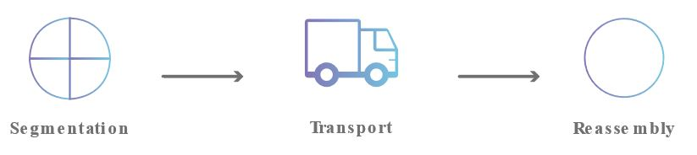
Transport Layer (Layer 4)
Responsible for end-to-end communication between the two devices
Takes data (from upper layer) and breaks into segments
Responsible for flow control and error control
Notes:
İki cihaz arasındaki uçtan uca iletişimden sorumlu
Verileri (üst katmandan) alır ve segmentlere ayırır
Akış kontrolü ve hata kontrolünden sorumlu
Katman 4, iki cihaz arasındaki uçtan uca iletişimden sorumludur.
Bu, oturum katmanından veri almayı ve onu 3. katmana göndermeden önce segment adı verilen parçalara ayırmayı içerir.
Alıcı cihazdaki taşıma katmanı, segmentleri oturum katmanının tüketebileceği verilere yeniden birleştirmekten sorumludur.
Taşıma katmanı ayrıca akış kontrolü ve hata kontrolünden de sorumludur.
Akış kontrolü, hızlı bağlantıya sahip bir göndericinin yavaş bağlantıya sahip bir alıcıyı boğmamasını sağlamak için en uygun iletim hızını belirler.
Taşıma katmanı, alınan verilerin eksiksiz olduğundan emin olarak ve eksikse yeniden iletim talep ederek alıcı uçta hata kontrolü gerçekleştirir.
Responsible for end-to-end communication between the two devices
Takes data (from upper layer) and breaks into segments
Responsible for flow control and error control
Layer 4 is responsible for end-to-end communication between the two devices. This includes taking data from the session layer and breaking it up into chunks called segments before sending it to layer 3. The transport layer on the receiving device is responsible for reassembling the segments into data the session layer can consume.
The transport layer is also responsible for flow control and error control. Flow control determines an optimal speed of transmission to ensure that a sender with a fast connection doesn’t overwhelm a receiver with a slow connection. The transport layer performs error control on the receiving end by ensuring that the data received is complete, and requesting a retransmission if it isn’t.

Slide 46

Network Layer (Layer 3)
Facilitates data transfer between two different networks
Takes data segments (from upper layer) and breaks into packets
Notes:
İki farklı ağ arasında veri aktarımını kolaylaştırır
Veri segmentlerini (üst katmandan) alır ve paketlere ayırır
Ağ katmanı, iki farklı ağ arasında veri aktarımını kolaylaştırmaktan sorumludur.
İletişim kuran iki cihaz aynı ağ üzerindeyse, ağ katmanı gereksizdir.
Ağ katmanı, taşıma katmanındaki segmentleri gönderenin cihazında paket adı verilen daha küçük birimlere ayırır ve bu paketleri alıcı cihazda yeniden birleştirir.
Ağ katmanı, verilerin hedefine ulaşması için en iyi fiziksel yolu da bulur; bu yönlendirme olarak bilinir.
Bir Frame, Data Link katmanında kullanılan bir veri birimi olarak tanımlanabilir. Öte yandan, bir paket ağ katmanında kullanılan protokol veri birimidir.
Çerçeveler OSI'nin veri bağlantı katmanında, Paketler ise Ağ katmanında oluşturulur.
Çerçeveleme, kaynak ve hedef MAC adreslerini (yani, makinenin fiziksel adresini) içerir. Buna karşılık, paketleme kaynak ve hedef IP adreslerini içerir.
Paket, ağ katmanındaki segmenti içine alır. Aksine, Kareler paketleri veri bağlantı katmanına yerleştirir.
Facilitates data transfer between two different networks
Takes data segments (from upper layer) and breaks into packets
The network layer is responsible for facilitating data transfer between two different networks. If the two devices communicating are on the same network, then the network layer is unnecessary. The network layer breaks up segments from the transport layer into smaller units, called packets, on the sender’s device, and reassembling these packets on the receiving device. The network layer also finds the best physical path for the data to reach its destination; this is known as routing.

Slide 47
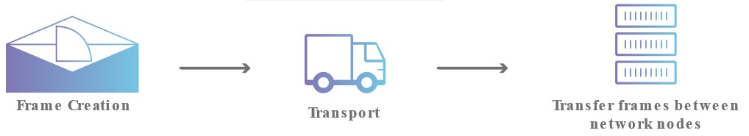
Data Link Layer (Layer 2)
Facilitates data transfer between two devices on the same network
Takes data packets (from upper layer) and breaks into frames
Responsible for flow control and error control
Notes:
Aynı ağdaki iki cihaz arasında veri aktarımını kolaylaştırır
Veri paketlerini (üst katmandan) alır ve çerçevelere böler
Akış kontrolü ve hata kontrolünden sorumlu
Veri bağlantı katmanı, SAME ağındaki iki cihaz arasında veri aktarımını kolaylaştırır. Veri bağlantı katmanı, paketleri ağ katmanından alır ve bunları çerçeve adı verilen daha küçük parçalara böler. Ağ katmanı gibi, veri bağı katmanı da ağ içi iletişimde akış kontrolü ve hata kontrolünden sorumludur.
Facilitates data transfer between two devices on the same network
Takes data packets (from upper layer) and breaks into frames
Responsible for flow control and error control
The data link layer facilitates data transfer between two devices on the SAME network. The data link layer takes packets from the network layer and breaks them into smaller pieces called frames. Like the network layer, the data link layer is also responsible for flow control and error control in intra-network communication

Slide 48
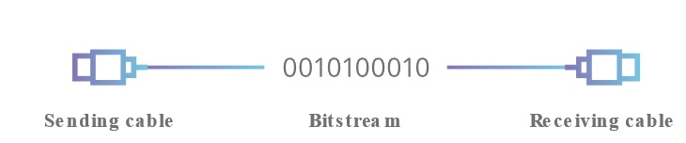
Physical Layer (Layer 1)
Includes physical equipment
cables repeaters modems
transceivers media converters hubs
etc.
Data is converted into bit streams
Notes:
Bu katman, kablolar ve anahtarlar gibi veri aktarımında yer alan fiziksel ekipmanı içerir.
Bu aynı zamanda verilerin 1'ler ve 0'lardan oluşan bir dizi olan bir bit akışına dönüştürüldüğü katmandır.
Her iki cihazın fiziksel katmanı, her iki cihazda da 1'lerin 0'lardan ayırt edilebilmesi için bir sinyal kuralı üzerinde anlaşmalıdır.
This layer includes the physical equipment involved in the data transfer, such as the cables and switches. This is also the layer where the data gets converted into a bit stream, which is a string of 1s and 0s. The physical layer of both devices must also agree on a signal convention so that the 1s can be distinguished from the 0s on both devices.

Slide 49
Data Encapsulation
3

Slide 50
Data Encapsulation
For two nodes communicate they must use the same protocol
Each layer (OSI or DoD) communicates with its equivalent layer on the other node via the lower layers of the model
Each layer provides services for the layer above and uses the services of the layer below
Notes:
İki düğümün iletişim kurması için aynı protokolü kullanmaları gerekir.Her katman (OSI veya DoD), modelin alt katmanları aracılığıyla diğer düğümdeki eşdeğer katmanıyla iletişim kurar.Her katman bir üstteki katmana hizmet sağlar ve alttaki katmanın hizmetlerini kullanır.İki düğümün iletişim kurabilmesi için aynı protokolü çalıştırmaları gerekir. Her katman, modelin alt katmanları aracılığıyla diğer düğümdeki eşdeğer (veya eş) katmanla iletişim kurar. Her katman bir üstteki katmana hizmet sağlar ve alttaki katmanın hizmetlerini kullanır.
For two nodes communicate they must use the same protocol
Each layer (OSI or DoD) communicates with its equivalent layer on the other node via the lower layers of the model
Each layer provides services for the layer above and uses the services of the layer below
For two nodes to communicate they must be running the same protocol. Each layer communicates with its equivalent (or peer) layer on the other node via the lower layers of the model. Each layer provides services for the layer above and uses the services of the layer below.

Slide 51
Data Encapsulation
Notes:
4 fr data
3 de segment parçalara ayrılıyor
2 frame
1 sinyal
Bir düğümden diğerine bir mesaj gönderildiğinde, gönderen düğümdeki katman yığınında aşağı doğru hareket eder, iletim ortamını kullanarak alıcı düğüme ulaşır ve sonra bu düğümdeki yığında yukarı geçer. Her düzeyde (fiziksel katman hariç), gönderen düğüm, bir Protokol Veri Birimi (PDU) oluşturan veri yüküne bir başlık ekler. Bu işlem kapsülleme olarak bilinir.Tipik bir yerel ağda, örneğin, gönderen düğümde, veriler, kendi uygulama başlığını içerecek olan HTTP gibi bir uygulama tarafından üretilir. Aktarım katmanında, bu uygulama verilerine bir TCP başlığı eklenir. Ağ katmanında, TCP segmenti bir IP başlığına sarılır. IP paketi, veri bağlantı katmanında bir Ethernet çerçevesine konur ve ardından çerçeveyi oluşturan bit akışı, fiziksel katmanda ağ üzerinden iletilir.Alıcı düğüm ters işlemi gerçekleştirir (kapsülden çıkarma veya kapsülden çıkarma). Örneğin, fiziksel katmana gelen bit akışını alır ve bir Ethernet çerçevesinin kodunu çözer. Bu çerçeveden IP paketini çıkarır ve IP başlığındaki bilgileri çözer, ardından aynısını TCP ve uygulama başlıkları için yapar ve sonunda bir yazılım programı tarafından işlenmek üzere uygulama verilerini çıkarır.Özetle, bir verici cihazda veri kapsülleme yöntemi şu şekilde çalışır:Kullanıcı bilgileri, ağ üzerinde iletilmek üzere verilere dönüştürülür.Veriler segmentlere dönüştürülür ve ileten ve alan ana bilgisayarlar arasında güvenilir bir bağlantı kurulur.Segmentler, paketlere veya datagramlara dönüştürülür ve her paketin bir ağ üzerinden yönlendirilebilmesi için başlığa mantıksal bir adres yerleştirilir.Paketler veya datagramlar, yerel ağda iletilmek üzere çerçevelere dönüştürülür. Donanım (Ethernet) adresleri, yerel bir ağ segmentindeki ana bilgisayarları benzersiz şekilde tanımlamak için kullanılır.Çerçeveler bit'e dönüştürülür ve dijital bir kodlama kullanılır.
When a message is sent from one node to another, it travels down the stack of layers on the sending node, reaches the receiving node using the transmission media, and then passes up the stack on that node. At each level (except the physical layer), the sending node adds a header to the data payload, forming a Protocol Data Unit (PDU). This process is known as encapsulation.
On a typical local network for example, on the sending node, data is generated by an application such as HTTP, which will include its own application header. At the transport layer, a TCP header is added to this application data. At the network layer, the TCP segment is wrapped in an IP header. The IP packet is put into an Ethernet frame at the data link layer then the stream of bits making up the frame is transmitted over the network at the physical layer.
The receiving node performs the reverse process (de-encapsulation or decapsulation). For example, it receives the stream of bits arriving at the physical layer and decodes an Ethernet frame. It extracts the IP packet from this frame and resolves the information in the IP header then does the same for the TCP and application headers, eventually extracting the application data for processing by a software program.
In summary, at a transmitting device, the data-encapsulation method works like this:
User information is converted to data for transmission on the network.
Data is converted to segments, and a reliable connection is set up between the transmitting and receiving hosts.
Segments are converted to packets or datagrams, and a logical address is placed in the header so each packet can be routed through an internetwork.
Packets or datagrams are converted to frames for transmission on the local network. Hardware (Ethernet) addresses are used to uniquely identify hosts on a local network segment.
Frames are converted to bits, and a digital encoding is used.

Slide 52
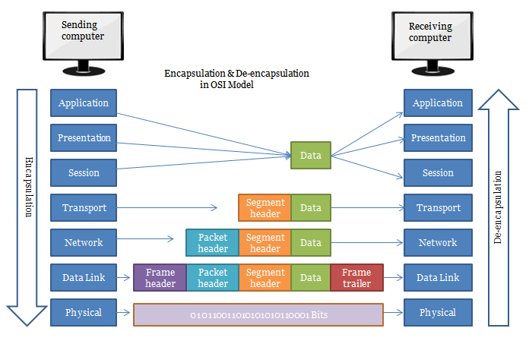
Data Encapsulation
Notes:
3 ıp ekleniyo
2 veri kontrol ekleri
Bir düğümden diğerine bir mesaj gönderildiğinde, gönderen düğümdeki katman yığınında aşağı doğru hareket eder, iletim ortamını kullanarak alıcı düğüme ulaşır ve sonra bu düğümdeki yığında yukarı geçer. Her düzeyde (fiziksel katman hariç), gönderen düğüm, bir Protokol Veri Birimi (PDU) oluşturan veri yüküne bir başlık ekler. Bu işlem kapsülleme olarak bilinir.Tipik bir yerel ağda, örneğin, gönderen düğümde, veriler, kendi uygulama başlığını içerecek olan HTTP gibi bir uygulama tarafından üretilir. Aktarım katmanında, bu uygulama verilerine bir TCP başlığı eklenir. Ağ katmanında, TCP segmenti bir IP başlığına sarılır. IP paketi, veri bağlantı katmanında bir Ethernet çerçevesine konur ve ardından çerçeveyi oluşturan bit akışı, fiziksel katmanda ağ üzerinden iletilir.Alıcı düğüm ters işlemi gerçekleştirir (kapsülden çıkarma veya kapsülden çıkarma). Örneğin, fiziksel katmana gelen bit akışını alır ve bir Ethernet çerçevesinin kodunu çözer. Bu çerçeveden IP paketini çıkarır ve IP başlığındaki bilgileri çözer, ardından aynısını TCP ve uygulama başlıkları için yapar ve sonunda bir yazılım programı tarafından işlenmek üzere uygulama verilerini çıkarır.Özetle, bir verici cihazda veri kapsülleme yöntemi şu şekilde çalışır:Kullanıcı bilgileri, ağ üzerinde iletilmek üzere verilere dönüştürülür.Veriler segmentlere dönüştürülür ve ileten ve alan ana bilgisayarlar arasında güvenilir bir bağlantı kurulur.Segmentler, paketlere veya datagramlara dönüştürülür ve her paketin bir ağ üzerinden yönlendirilebilmesi için başlığa mantıksal bir adres yerleştirilir.Paketler veya datagramlar, yerel ağda iletilmek üzere çerçevelere dönüştürülür. Donanım (Ethernet) adresleri, yerel bir ağ segmentindeki ana bilgisayarları benzersiz şekilde tanımlamak için kullanılır.Çerçeveler bit'e dönüştürülür ve dijital bir kodlama kullanılır.
When a message is sent from one node to another, it travels down the stack of layers on the sending node, reaches the receiving node using the transmission media, and then passes up the stack on that node. At each level (except the physical layer), the sending node adds a header to the data payload, forming a Protocol Data Unit (PDU). This process is known as encapsulation.
On a typical local network for example, on the sending node, data is generated by an application such as HTTP, which will include its own application header. At the transport layer, a TCP header is added to this application data. At the network layer, the TCP segment is wrapped in an IP header. The IP packet is put into an Ethernet frame at the data link layer then the stream of bits making up the frame is transmitted over the network at the physical layer.
The receiving node performs the reverse process (de-encapsulation or decapsulation). For example, it receives the stream of bits arriving at the physical layer and decodes an Ethernet frame. It extracts the IP packet from this frame and resolves the information in the IP header then does the same for the TCP and application headers, eventually extracting the application data for processing by a software program.
In summary, at a transmitting device, the data-encapsulation method works like this:
User information is converted to data for transmission on the network.
Data is converted to segments, and a reliable connection is set up between the transmitting and receiving hosts.
Segments are converted to packets or datagrams, and a logical address is placed in the header so each packet can be routed through an internetwork.
Packets or datagrams are converted to frames for transmission on the local network. Hardware (Ethernet) addresses are used to uniquely identify hosts on a local network segment.
Frames are converted to bits, and a digital encoding is used.

Slide 53
THANKS!
Any questions?
You can find me at:
@David - Instructor
david@clarusway.com

